Slide 1
Clipping
Sutherland-Hodgman Polygon Clipping

Slide 2
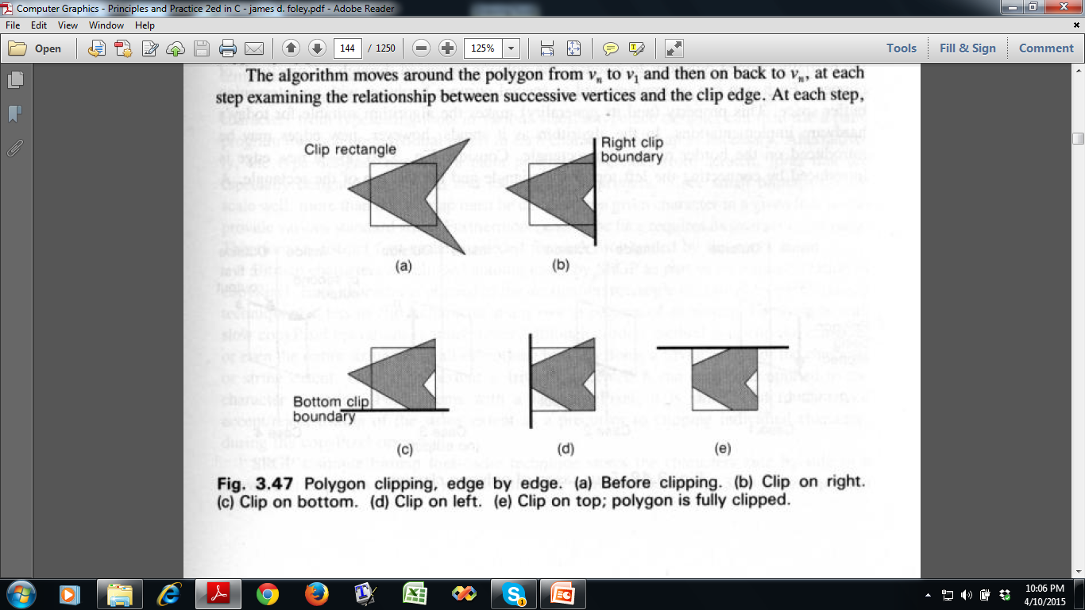
Sutherland-Hodgman Polygon Clipping

Slide 3
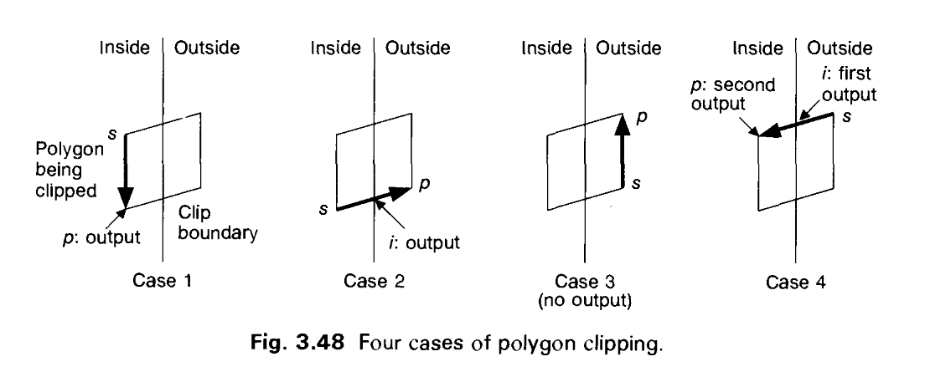
Sutherland-Hodgman Polygon Clipping
Divide and Conquer Strategy
Clip against a single infinite clip edge and get new vertices
Repeat for next clip edge
Adding Vertices to Output List

Slide 4
Sutherland-Hodgman Polygon Clipping
Input:
Polygon described by an input of list of vertices: v₁, v₂, …,v_{n}
Convex clip region C
Algorithm:
Inputlist : v₁, v₂, …,v_{n}
For each clip edge e in E do
S 🡨 v_{n}
P 🡨 v₁
j 🡨 1
While (j<n)
do, if both S & P inside the clip region,
Add p to output list else if S inside & P outside, then Find intersection point i Add i to output list else if S outside and P inside, then find intersection point i add i to output list add P to output list else if S and P both outside do nothing
S 🡨 v_{j}
P 🡨 v_{j+1}
i ++
inputlist 🡨 current output list

Slide 5
Sutherland-Hodgman Polygon Clipping
a
b
a, b, c, d, e, f, g
S = g, P = a
Output: 1, 2, c, d, e, f, g
1
2
e
g
d
f
c
SP | Intersection | Output | Comments
g, a | 1 | 1 | g inside, a outside
a, b | - | - | Both outside
b, c | 2 | 2,c | b outside, c inside
c, d | - | d | Both inside
d, e | - | e | Both inside
e, f | - | f | Both inside
f, g | - | g | Both inside

Slide 6
Sutherland-Hodgman Polygon Clipping
a
b
Output of previous iteration 1, 2, c, d, e, f, g
S = g, P = 1
Output: 3, 1, 4, 5, d, e, f, 6
4
1
2
3
e
6
g
d
f
5
c
SP | Intersection | Output | Comments
g,1 | 3 | 3,1 | g outside, 1 inside
1, 2 | 4 | 4 | 1 inside, 2 outside
2, c | - | - | Both outside
c, d | 5 | 5,d | d inside, c outside
d, e | - | e | Both inside
e, f | - | f | Both inside
f, g | 6 | 6 | f inside, g outside

Slide 7
Sutherland-Hodgman Polygon Clipping
b
a
b
Output of previous iteration 3, 1, 4, 5, d, e, f, 6
S = 6, P = 3
Output: 3, 1, 4, 7, 8, e, 9, 10, 6
4
1
2
3
e
6
g
9
8
10
7
d
f
5
c
SP | Intersection | Output | Comments
6, 3 | - | 3 | Both inside
3, 1 | - | 1 | Both inside
1, 4 | - | 4 | Both inside
4, 5 | 7 | 7 | 4 inside, 5 outside
5, d | - | - | Both outside
d, e | 8 | 8, e | e inside, d outside
e, f | 9 | 9 | e inside, f outside
f, 6 | 10 | 10, 6 | 6 inside, f outside

Slide 8
Sutherland-Hodgman Polygon Clipping
a
b
Output of previous iteration 3, 1, 4, 7, 8, e, 9, 10, 6
S = 6, P = 3
Output: 3, 1, 4, 7, 11, 12, e, 9, 10, 6
4
1
2
3
e
12
6
g
9
8
11
10
7
d
f
5
c
SP | Intersection | Output | Comments
6, 3 | - | 3 | Both inside
3, 1 | - | 1 | Both inside
1, 4 | - | 4 | Both inside
4, 7 | - | 7 | Both inside
7, 8 | 11 | 11 | 7 inside, 8 outside
8, e | 12 | 12, e | e inside, 8 outside
e, 9 | - | 9 | Both inside
9, 10 | - | 10 | Both inside
10, 6 | - | 6 | Both inside

Slide 9
Clipping Circles (and Ellipses)
Analytical
Intersect circle’s extent (square of size of circle’s diameter) with clip rectangle
Run the algorithm of polygon clipping
No intersect : trivial reject
Intersect : divide into quadrants (and later octants if needed) and repeat
Compute intersection by solving equations
During Scan Conversion
When circle is relatively small or scan conversion is fast
After extent checking scissor on a pixel by pixel basis
Similar Approach for Ellipses!

Slide 10
Thank you ☺

